Slide 1
Expectations afternoon EYFS

Slide 2

‘New’ EYFS
https://assets.publishing.service.gov.uk/government/uploads/system/uploads/attachment_data/file/974907/EYFS_framework_-_March_2021.pdf

Slide 3
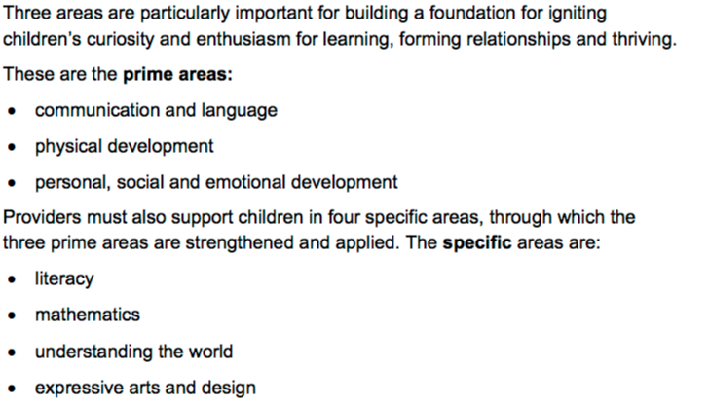

Slide 4
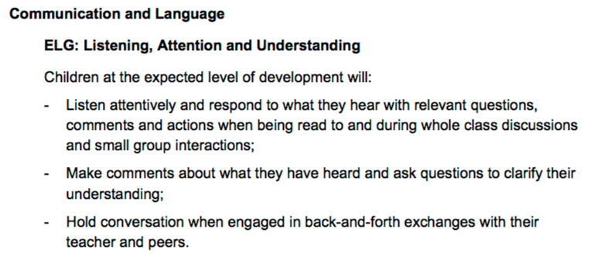

Slide 5
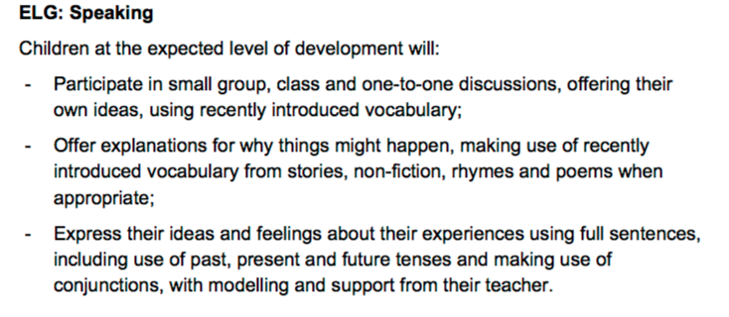

Slide 6
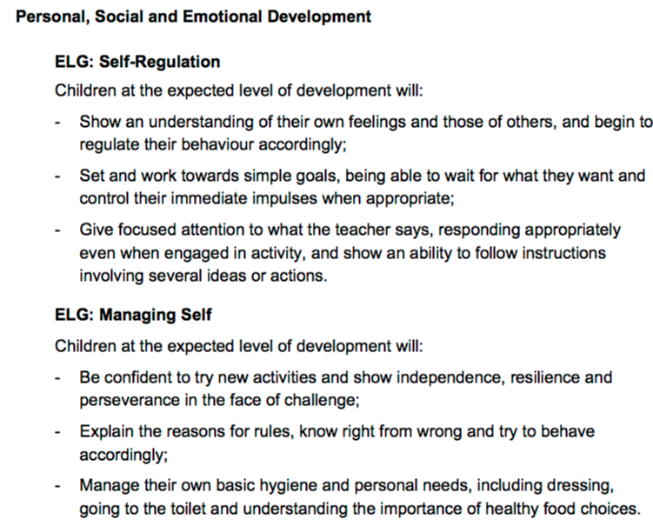

Slide 7
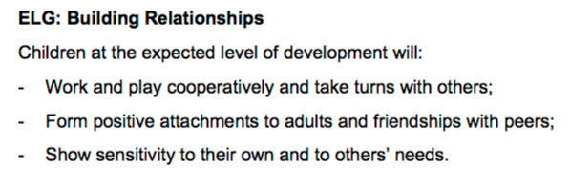

Slide 8
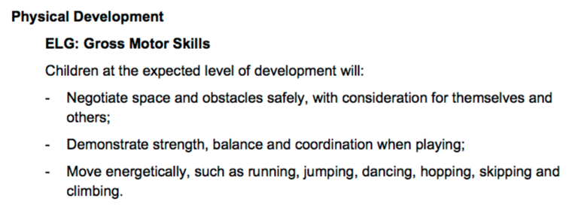
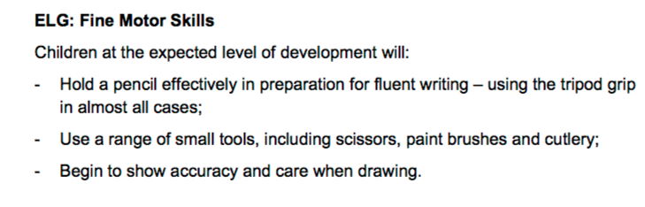

Slide 9
Literacy/phonics…

Slide 10
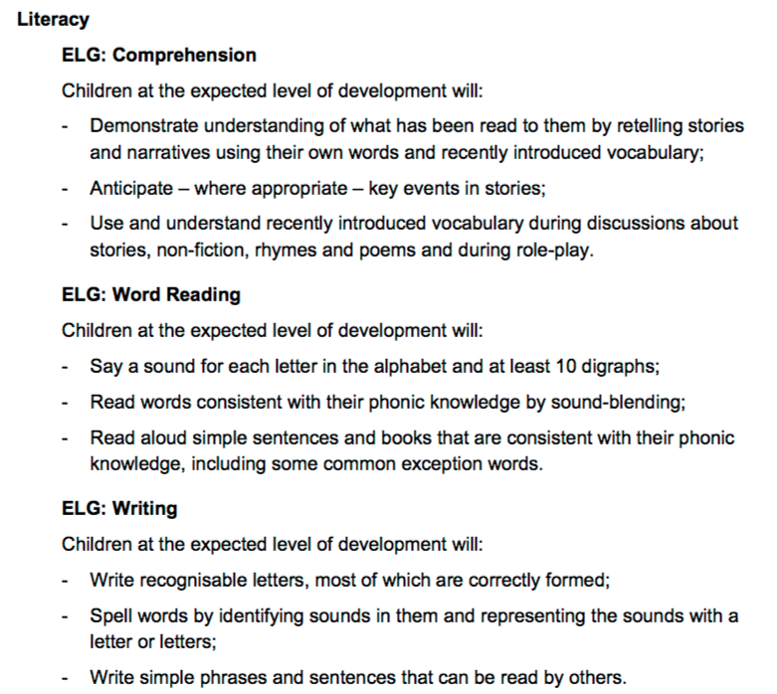

Slide 11
What makes a skilled and confident reader?
Opportunities to:
Learn about print and books (hold them the right way up, reading left to right and turning pages one at a time)
Learn about the sounds in spoken language (this is called phonological awareness)
Learn about the letters of the alphabet and how they come together to form words.
Listen to books read aloud
Every one of these elements is vital!

Slide 12
Listening to books read aloud
Reading aloud =
single most important activity for building knowledge required for success in reading (and writing!).

Slide 13
Literacy rich home environment
How?
Establish a regular time (before bed/bath time works well)
Keep a large variety of reading materials at hand
Store books/materials in places children can access
Share your love of books with them/the joy of reading!
Have paper and writing tools available along side
Model reading and writing for pleasure
Make time for conversations about books and reading
Use board games to reinforce language/literacy skills

Slide 14
Engaging your child
Build a home library
Let your child choose the book
Use funny voices!
Tap into their interests
Take books with you on journeys or shopping trips
Use technology to your advantage – Oxford reading tree.

Slide 15
In school at the moment..
At the moment the children will have a library book which they can enjoy sharing with you and they will also have one of our Word Sparks books.
These Word Sparks books are to build on the children’s language and storytelling skills. Inside they have great ideas and questions to maximise children's understanding of the story.
As their phonological knowledge grows they will also bring home a fully decodable book so that they can practice their sounding out and blending skills.
We know its repetitive but to develop the children's reading skills we recommend each book to be read 3 times.

Slide 16
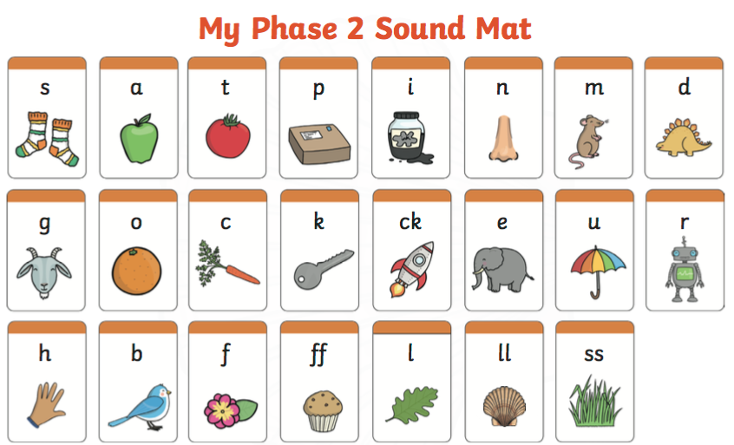

Slide 17
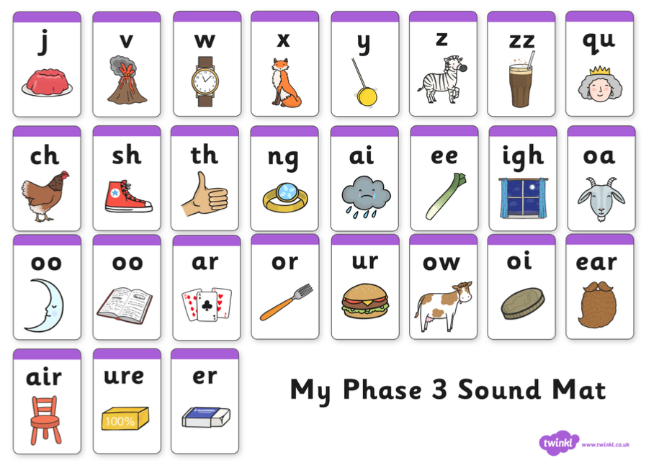

Slide 18
Supporting your child with reading
Reception
Phonics: children in Reception will be learning Phase 2, Phase 3 and Phase 4.
Banded books are decodable so allow children to practice segmenting a word by saying the pure sounds and then blending it back together.
There are some words that cannot be decoded. These are words that children just have to know by sight. (the, I, into, into, no, go, so etc.) We call these ‘tricky’ or ‘sight’ words.

Slide 19
Supporting your child with reading
Use phonics first – saying the sound/doing the action.
Use ‘book talk’ – talk about stories and story language, key features of the book, word level – words, sentences, punctuation, features on the page e.g. speech bubbles
Check understanding – encourage use of picture clues to help understanding, also show your child how you might be able to predict the meaning from other word clues.
Use question prompts to help deepen your child’s understanding and support their reading development
Model by reading them a story.

Slide 20
Extra support:
TALK TALK TALK! To your children.
You reading aloud to your child shows you value reading

Slide 21
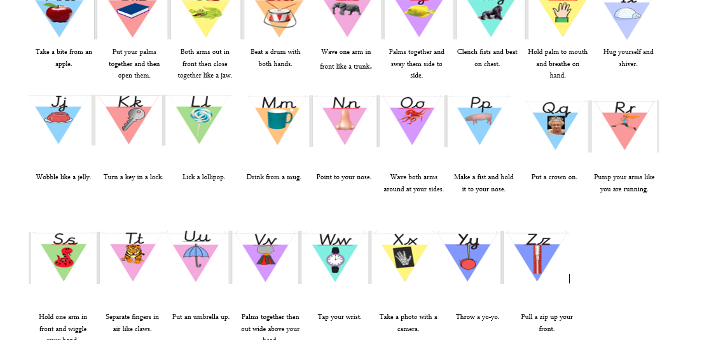
Actions (might have changed)

Slide 22
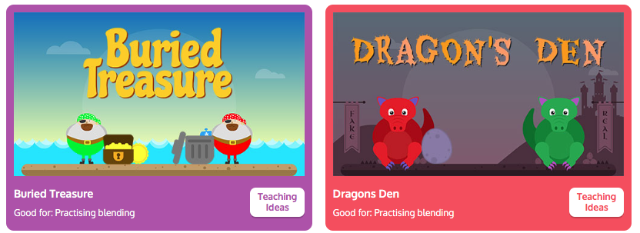
Games..
Eye spy
https://www.phonicsplay.co.uk/resources
Sight word swat –
Write down CVC words and sight words.
Call out the word.. Can they swat it with their hand?
Find something that begins with (a letter in the alphabet).

Slide 23
Mathematics…

Slide 24
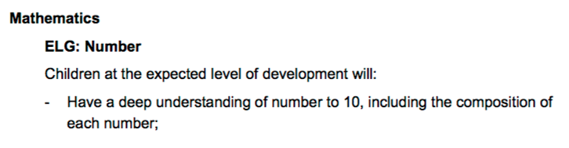
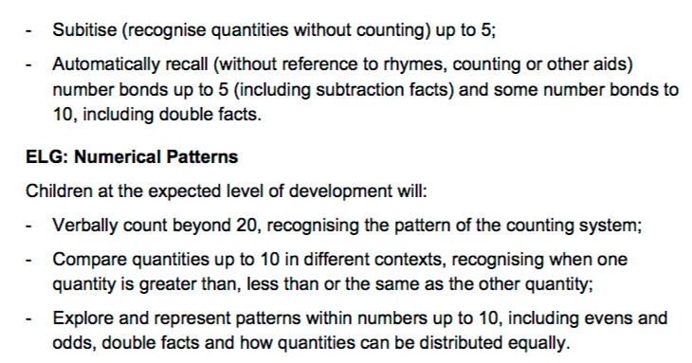

Slide 25
Supporting your child with their mathematics…
Counting how many steps to.. The kitchen, bathroom etc.
Counting how many cars, vans etc. You see on the way home from school.
Talking about speed sighs (30,40,50 etc.)
Cooking with your children at home and weighing out ingredients.
Make 3D models using recycling. What different shapes are there?
Go on a shape hunt (2D and 3D)
Whats the time Mr wolf?
Play board games.
Challenge to beat a timer (tidying up). THEY LOVE THIS IN CLASS!
Can they collect a certain amount of objects?
Top marks - https://www.topmarks.co.uk
Talking about the time in ‘real time’. Example in 5 minutes it will be 10.30 etc.

Slide 26

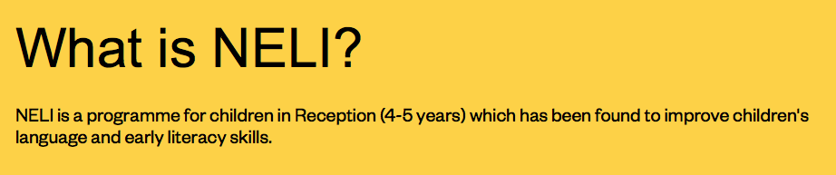
We will be using NELI to boost talk and develop language and
early literacy skills.
https://www.teachneli.org/what-is-neli/

Slide 27
Questions….
THANK YOU FOR YOUR TIME TODAY ☺

